Slide 1
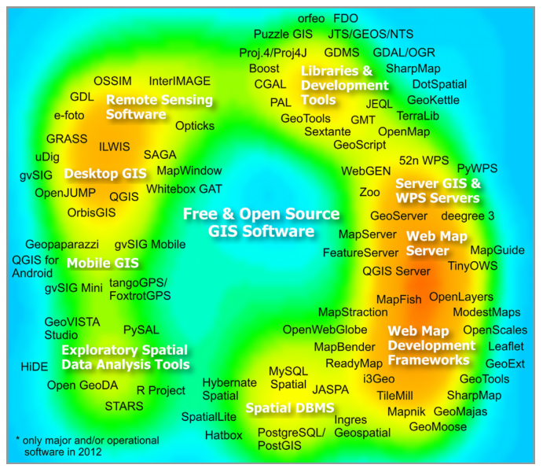
Open Science and Github
Dr. Jerry Shannon

Slide 2
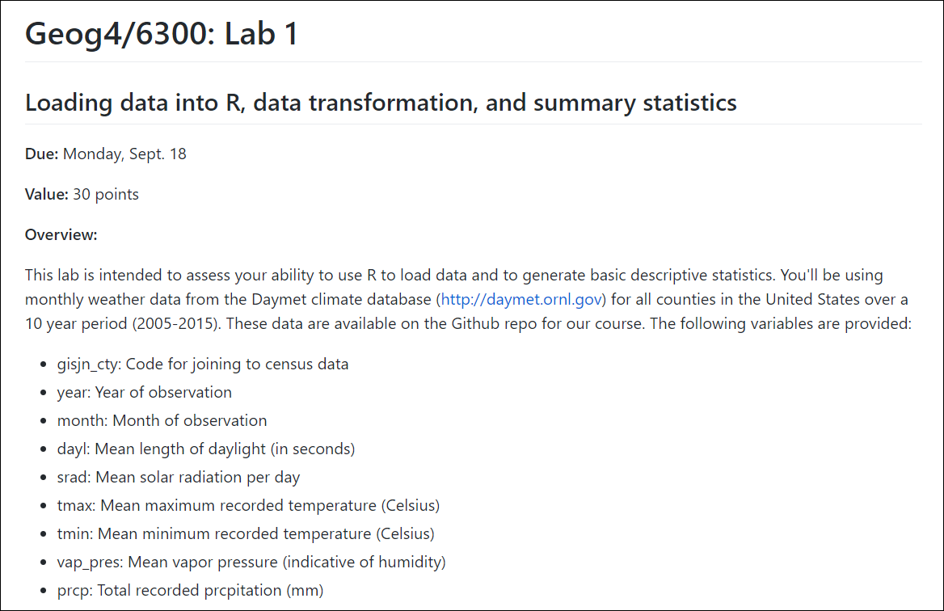

Slide 3


Slide 4
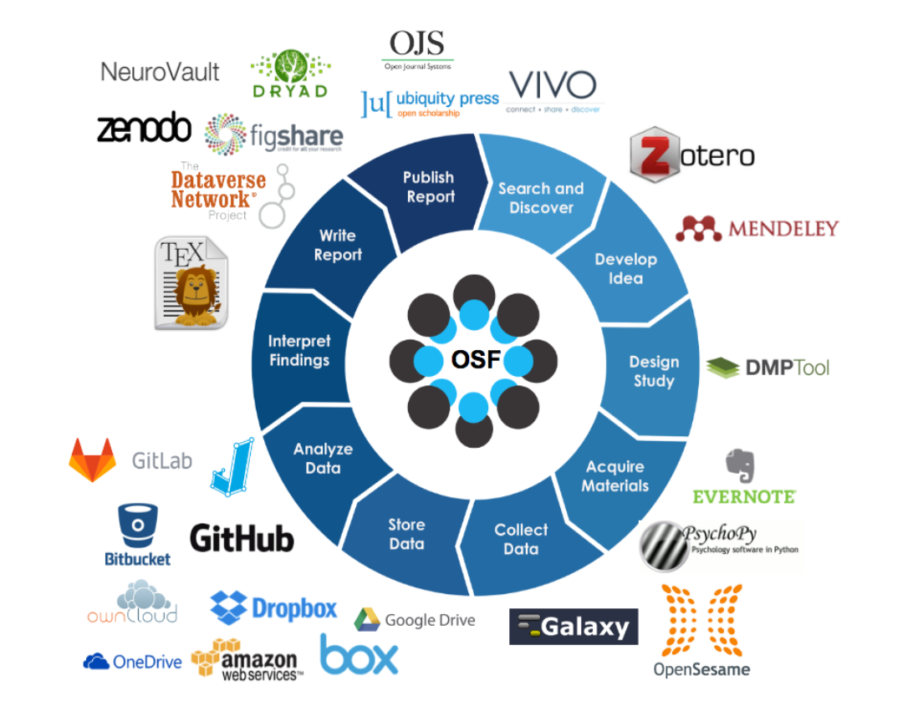

Slide 5







Open GIScience

Slide 6
Open Software
Steiniger, S., & Hunter, A. J. S. (2013). The 2012 free and open source GIS software map – A guide to facilitate research, development, and adoption. Computers, Environment and Urban Systems, 39, 136–150. Link

Slide 7

Desktop GIS

Slide 8

Statistical analysis/modeling

Slide 9
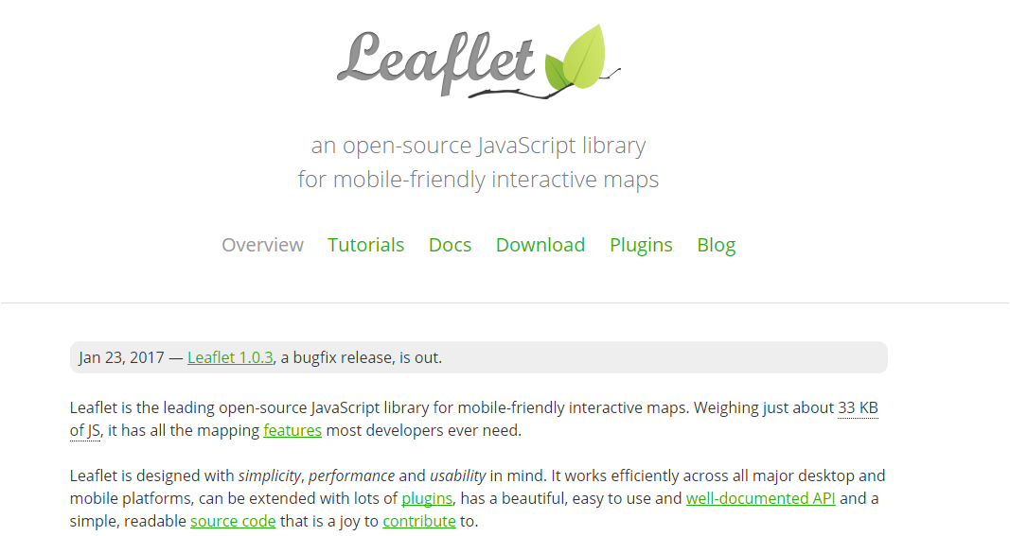
Javascript libraries

Slide 10

Spatial databases

Slide 11
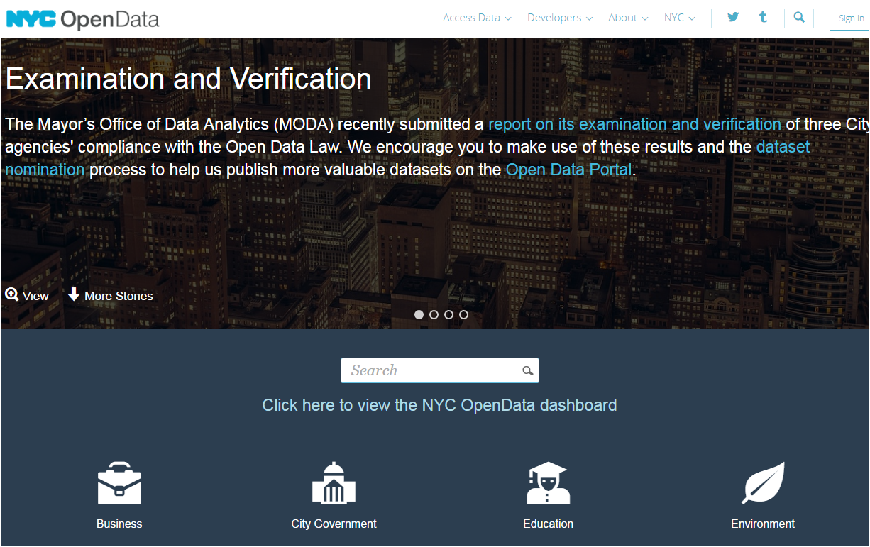
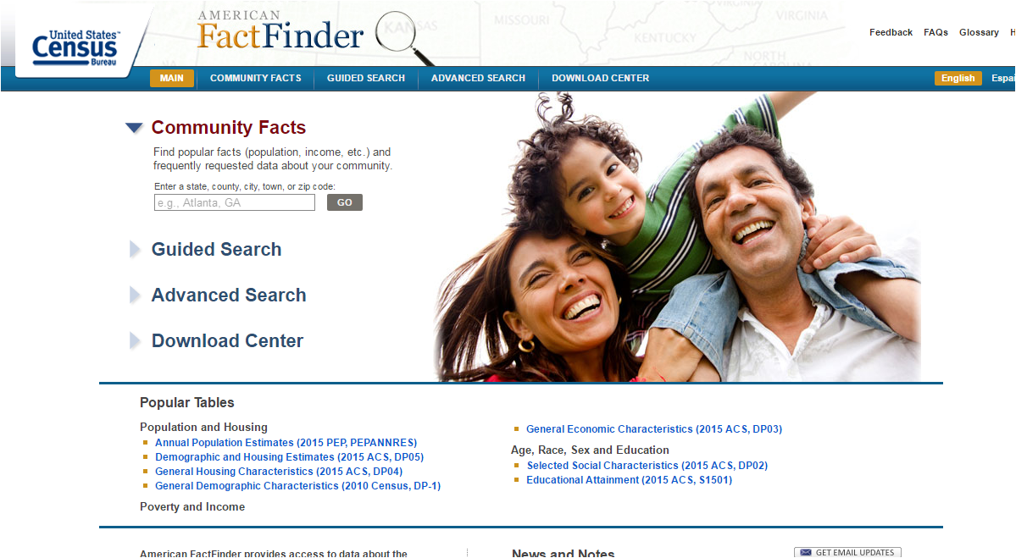
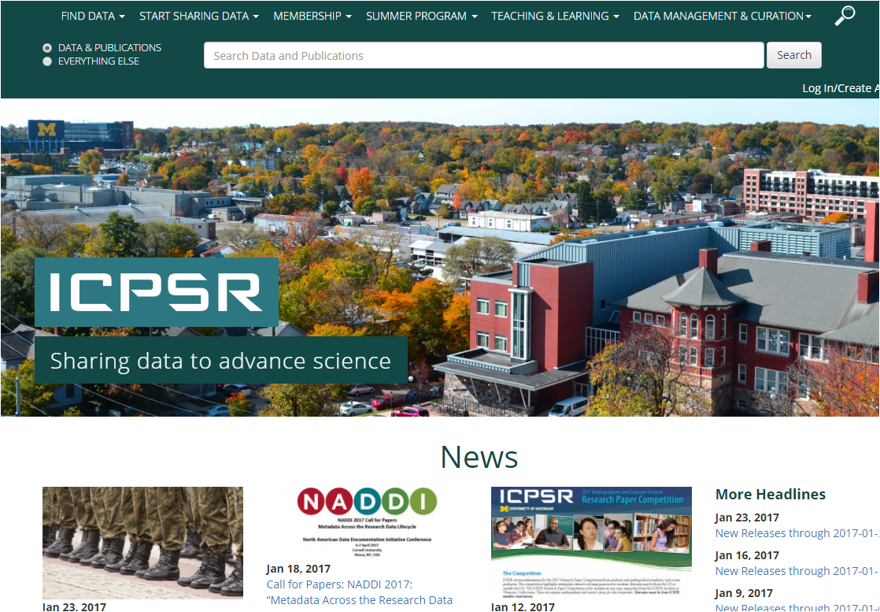
Open Data

Slide 12
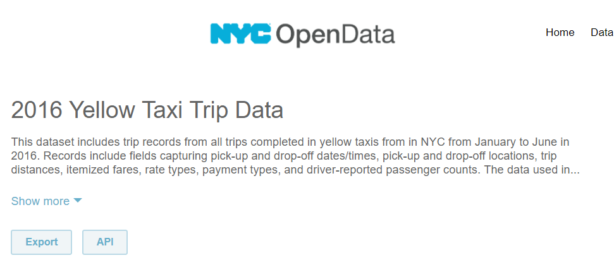

NYC Taxis
Link

Slide 13
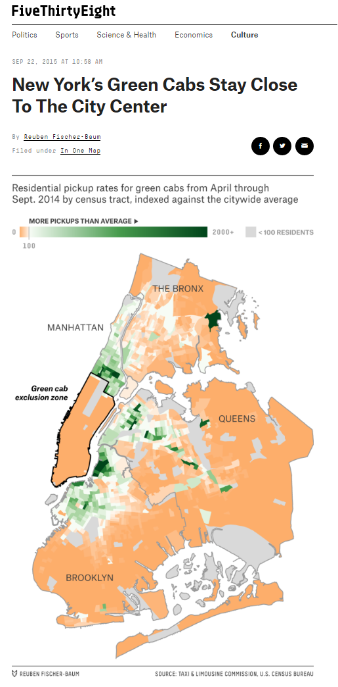
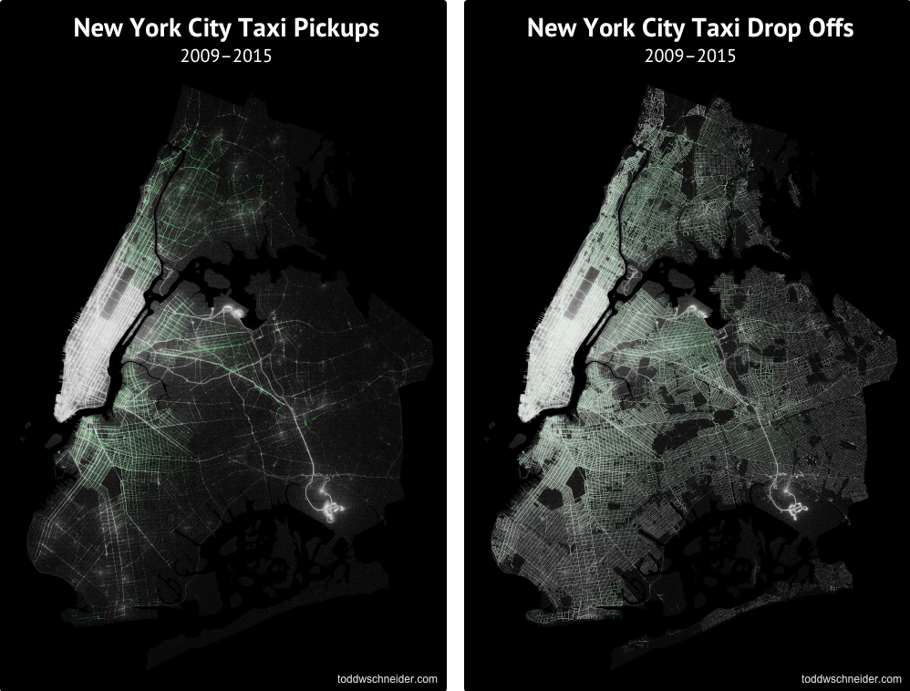
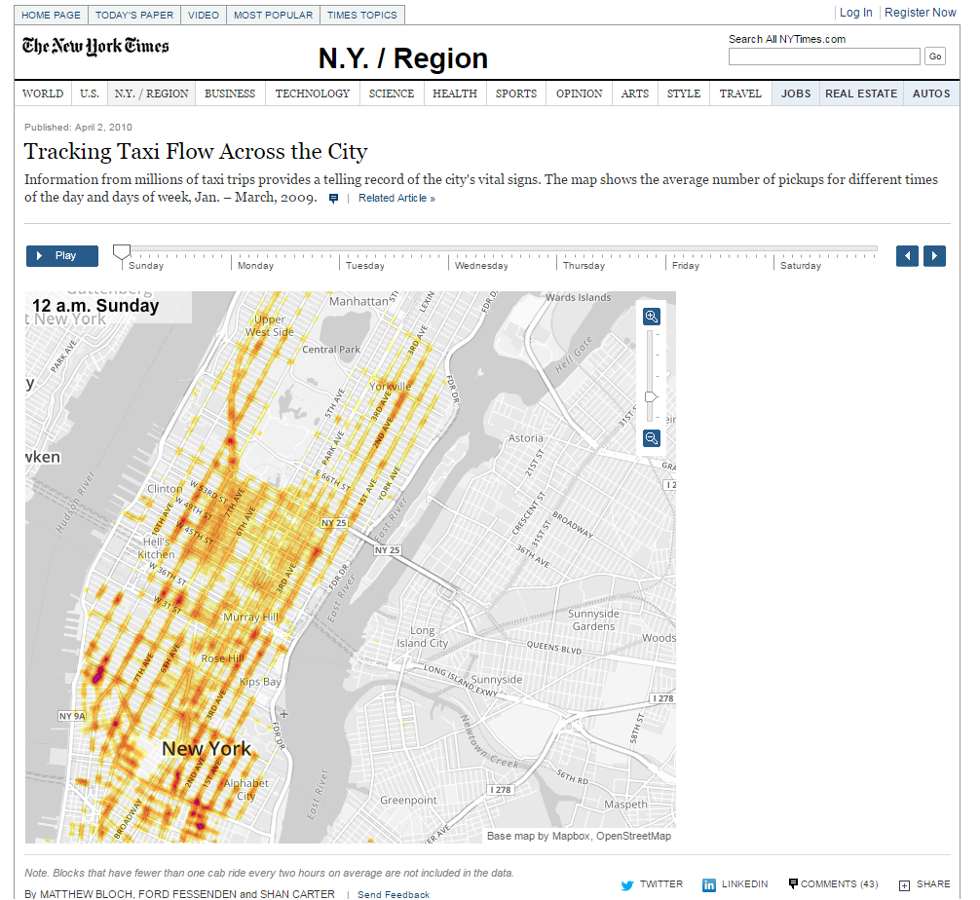
NYC Taxis

Slide 14
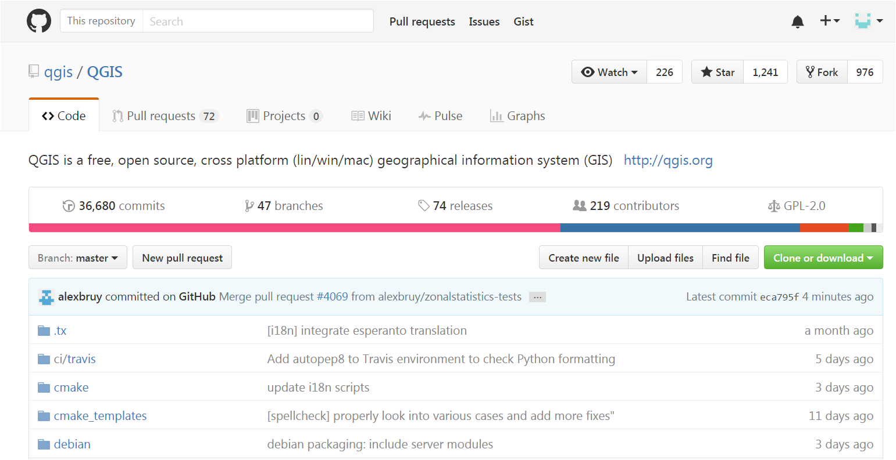
Open Code

Slide 15
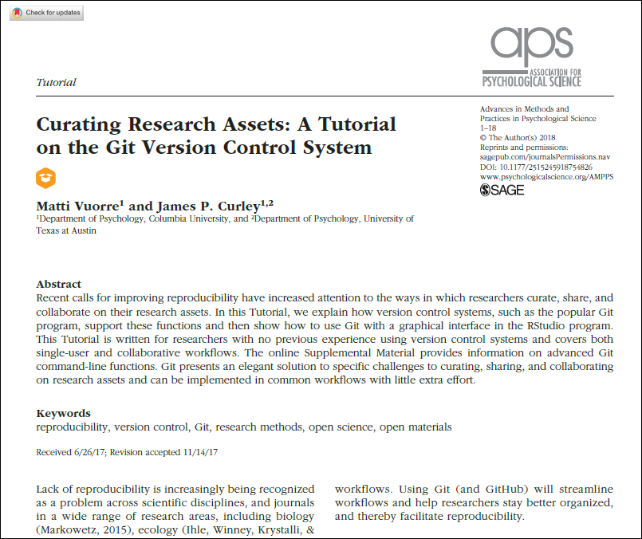
Why use Git/Github?

Slide 16

Your task: Create a Github account and join the lab assignment. Clone your repo to a working folder.

Slide 17
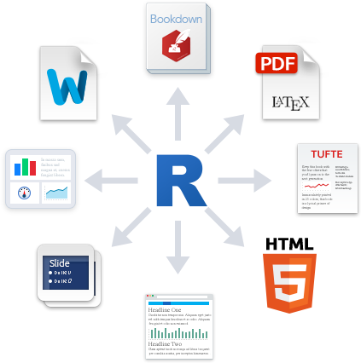


Markdown: A code based formatting tool for text documents.

Slide 18
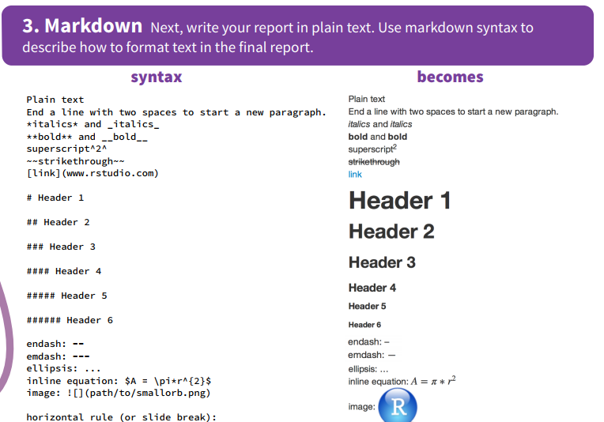

Slide 19
Why are we using Rmarkdown?
Provides an easy way to share code and your results.
Results always match the code
Readable formatting for code
No cutting and pasting needed

Slide 20
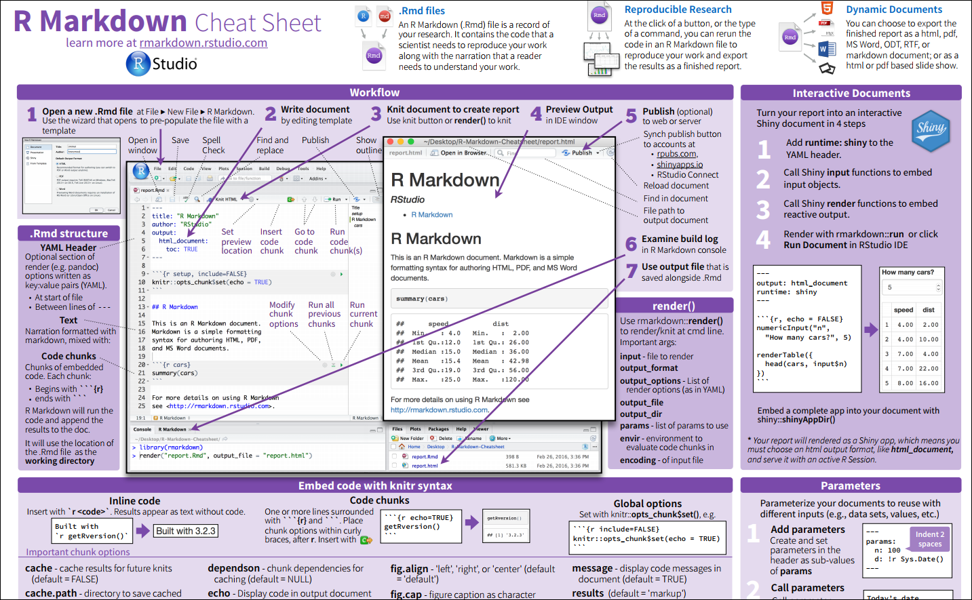
https://www.rstudio.com/wp-content/uploads/2016/03/rmarkdown-cheatsheet-2.0.pdf

Slide 21

Take it up a notch! Add code in your lab response that loads the lab data. Knit the document. Then push it to your repo.

Slide 22

Final challenge! Fork the Sandbox repo: https://github.com/jshannon75/sandbox Add a favorite children’s book.

